Slide 1
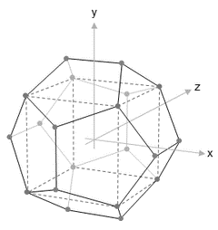
NISRA
Data Science Bootcamp
WELCOME
Course Title – Week 7 Python for Data Science
Course Tutor: Ashish Kumar
30th Jan – 3rd Feb 2017

Slide 2
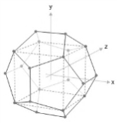

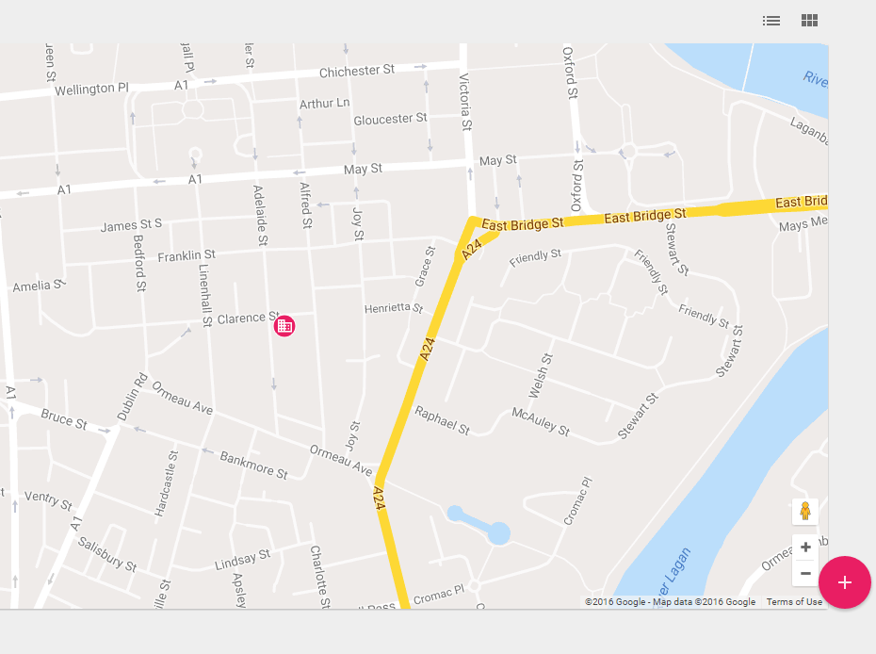
Course Locations
Location 1: ‘The Stables’, Stormont Castle
Location 2: ‘iD Lab’, Adelaide Street, Belfast

Slide 3
Your Attention Please
Fire Alarm
There are no fire alarm tests scheduled for today. So, if you do hear the fire alarm siren, or announcements asking you to leave the building, please leave immediately by the nearest available exit.
Staff in high visibility jackets will direct you to the assembly point.
Please take a moment to locate the exits around you now.
Toilets
The NISRA Stables Training Room toilets are located…..<to complete>
The Intelligent Datalytics toilets are located on your left as you enter the office.
Refreshments
The NISRA kitchen for coffee and tea is available…<to complete>
Vending machines are available for refreshments on the 1st Floor of the Premier Business Centre.

Slide 4
Content Summary
Day 2 | Data preparation with Python 1 | Details | Start | End | Format
 | Reading/Writing data | Understanding a Data Frame Basics of Pandas Reading a dataset: CSV, JSON, URL,XLSX Connecting to a database | 09:00 | 10.30 | Taught /Practical
 | Data Explorations | Preview of the read dataset Basic Stats / Data types of the dataset Data type conversion | 10.45 | 12.15 | Taught /Practical
 | Python Basic Lab1 | Sub-setting a Data Frame Creating a new /renaming column in Dataframe Writing data to a csv file | 13.00 | 14.30 | Taught /Practical
 | Data Wrangling | Handling missing values Sort a dataset Transpose dataset | 14.45 | 16.15 | Taught /Practical
 | Wrap up / Q & A Discussion |  | 16.15 | 16.45 | Q&A

Slide 5
Content Summary
Day 3 | Data preparation with Python 2 | Details | Start | End | Format
 | Data Transformation | Identifying unique values Removing duplicate values of a variable Sample rows from dataset Creating a simulation | 09:00 | 10.30 | Taught /Practical
 | Data Transformation | Aggregating a function (Groupby) Applying functions | 10.45 | 12.15 | Taught /Practical
 | Data Transformation | Merging datasets Pivot tables | 13.00 | 14.30 | Taught /Practical
 | Data Transformation | Lag & Rolling functions Creating a dummy variable Creating a dataset | 14.45 | 16.15 | Taught /Practical
 | Wrap up / Q & A Discussion |  | 16.15 | 16.45 | Q&A

Slide 6
Day 2&3: Data Wrangling
Reading/Writing Data Files
Basic Exploration of Data
Data Processing
Data Cleaning
Data Summarisation
Data Aggregation
Statistics & Random Numbers
Linear Algebra

Slide 7
Loading Data Files
Various methods of reading a dataset in Python
Method | Description
read_csv | Read a delimited file with a default comma ‘,’ delimiter
json_loads | Reads json objects
read_table | Read a delimited file with a default comma ‘/t’ delimiter
open | Open method is used to read a file line by line
read_xlsx | Read an Excel file with multiple sheets
Load from URL | Loading data from URL

Slide 8
Loading Data Files
Steps in reading a dataset in Python
Steps | Description
Step 1 | Import required Python packages e.g. os, pandas, numpy etc.
Step 2 | Change the current directory to the directory where data is present
Step 3 | Use one of the methods above to read in the data
import os
import pandas as pd
directory_name=‘F:/Work/Philip Adams/Course Content/Data’
os.chdir(directory_name)

Slide 9
Loading Data Files
read_csv
pd.read_csv(filepath, sep=’, ’, dtype=None, header=None, names=None, skiprows=None, index_col=None, skip_blank_lines=TRUE, na_filter=TRUE)
filepath – filename/filepath
dtype – specify data type of the column name
header – specifying the row with header
names – specify column names for a dataset
skiprows=skip caertain rows of data
index_col – specify the column which can work as row number
skip_blank_lines – specify whether to skip blank lines or not
na_filter – specify whether to filter NA values or not

Slide 10
Loading Data Files
read_csv
Example 1 : data=pd.read_csv('Hospital Cost.csv')
Example 2: data2=pd.read_csv('Customer Churn Model.txt')
Example 3: data3=pd.read_csv('Tab Customer Churn Model.txt',sep='/t')
Example 4: column_names=pd.read_csv('Customer Churn Columns.csv')
column_names_list=column_names['Column Names'].tolist()
data4=pd.read_csv('Customer Churn Model.txt',header=None,names=column_names_list)

Slide 11
Loading Data Files
read_xlsx
Example 1: data5=pd.read_excel('SRS Career.xlsx',sheetname='Sachin')
Example 2: data6=pd.read_excel('SRS Career.xlsx',sheetname=1)
Example 3: data7=pd.read_excel('SRS Career.xlsx',sheetname=None)
(returns a dict of dataframes with sheetnames as the keys) ; data7['Sachin']

Slide 12
Loading Data Files
xlrd
Code snippet | Goal achieved
import xlrd | Importing xlrd
book=xlrd.open_workbook('SRS Career.xlsx') | Reading the Excel workbook
n=book.nsheets | Finding the number of sheets in workbook
book.sheet_names() | Finding the names of sheets in workbook
last_sheet=book.sheet_by_index(n-1) | Reading the sheets by sheet index
last_sheet.row_values(0) | Getting the 1st row of a sheet
last_sheet.cell(0,0) | Getting 1st cell of the sheet
last_sheet.row_slice(rowx=0,start_colx=1,end_colx=5) | Getting 1st to 5th columns of 1st row

Slide 13
Loading Data Files
open
# Finding the total number of columns in a file
data=open('Customer Churn Model.txt','r')
cols=data.next().strip().split(',')
ncols=len(cols)
# Reading the file line by line
for line in open('Customer Churn Model.txt'):
values=line.strip().split(',')
print values
open
# Reading data as a dict line-by-line
counter=0
main_dict={}
for col in cols:
main_dict[col]=[]
for line in open('Customer Churn Model.txt'):
values = line.strip().split(',')
for i in range(len(cols)):
main_dict[cols[i]].append(values[i])
counter += 1
print "The dataset has %d rows and %d columns" % (counter,ncols)

Slide 14
Loading Data Files
Reading data from URL
Example 1:
medal_data=pd.read_csv('http://winterolympicsmedals.com/medals.csv')
Example 2:
import csv
import urllib2
url="http://archive.ics.uci.edu/ml/machine-learning-databases/iris/iris.data"
response=urllib2.urlopen(url)
cr=csv.reader(response)
for rows in cr:
print rows

Slide 15
Loading Data Files
read_table
read_table is similar to read_csv.
In fact, read_csv is read_table with only some of the read_table options specified
For read_table, one has to specify the delimiter.
data8=pd.read_table('Customer Churn Model.txt',sep=',')
data8.head()

Slide 16
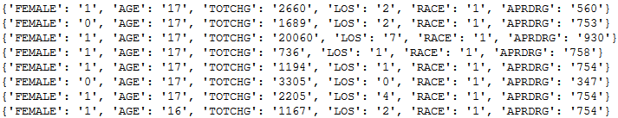
Loading Data Files
csv as dict
import csv
csvfile=open('Hospital Cost.csv','r')
csv_dict=csv.DictReader(csvfile)
for row in csv_dict:
print row
for row in csv_dict:
print row[‘FEMALE’]

Slide 17
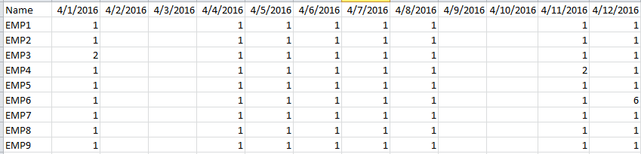
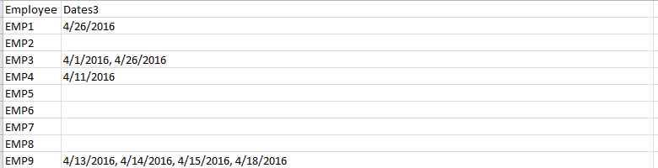
Loading Data Files
csv as dict

Slide 18
Loading Data Files
csv as dict
Steps:
Define a dictionary with employee ID as key
Loop over rows followed by a loop over columns
Look for value 2. 2 represents absence
Append such dates to dictionary for that particular employee
Write the dictionary to a csv file
Clean up the values

Slide 19
Loading Data Files
import csv
file_path='Apr_att.csv'
with open(file_path,'rb') as f:
reader=csv.DictReader(f)
fields=reader.fieldnames
#print fields
#headers=reader.next()
final_dict={}
for row in reader:
final_dict[row['Name']]=[]
for col in fields:
if row[col]=='2':
final_dict[row['Name']].append(col)
print row['Name'],col
with open('att_dict.csv', 'wb') as csv_file:
writer = csv.writer(csv_file)
for key, value in final_dict.items():
writer.writerow([key, value])
data=pd.read_csv('att_dict.csv',names=["Employee","Dates"])
data['Dates1'] = data['Dates'].map(lambda x: x.replace("]",""))
data['Dates2'] = data['Dates1'].map(lambda x: x.replace("[",""))
data['Dates3'] = data['Dates2'].map(lambda x: x.replace("'",""))
data.head()
final_df=data[['Employee','Dates3']]
final_df.to_csv('final_att.csv',index=False)

Slide 20
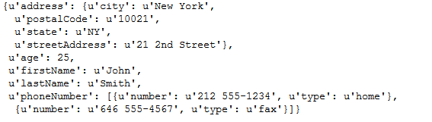
Loading Data Files
Reading JSON files
import json
with open('jsonex.json') as json_string:
d=json.load(json_string)
d

Slide 21
Loading Data Files
Reading JSON files
d is a dictionary
d['age']
d['address']['city']
for keys,values in d['address'].items():
print keys,values

Slide 22
Loading Data Files
Reading JSON files
Reading Youtube JSON file
import json
with open('jsonex1.json') as json_string:
d=json.load(json_string)
d
for keys,values in d.items():
print keys
for keys,values in d['data'].items():
print keys

Slide 23
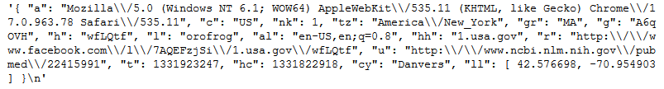
Loading Data Files
Reading JSON files
f=open('usagov_bitly.txt','r').readline()
d=json.loads(f)
records=[]
f=open('usagov_bitly.txt','r')
for i in range(1000):
fiterline=f.readline()
d=json.loads(fiterline)
records.append(d)
f.close()
# reading the file line by line and creating a list of records

Slide 24
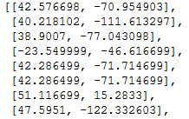
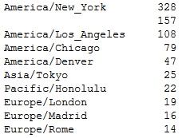
Loading Data Files
Reading JSON files
latlong=[rec['ll'] for rec in records if 'll' in rec]
import pandas as pd
df=pd.DataFrame(records)
df.head()
df['tz'].value_counts()

Slide 25
Loading Data Files
Reading JSON files
f=open('usagov_bitly.txt','r')
records=[json.loads(line) for line in f]
len(records)
records[2000]

Slide 26
Loading Data Files
Creating JSON file from data frame
import json
data_json=data1.to_json(orient='records')
import json
data_json=data1.to_json(orient=‘index')
Default method to orient is ‘columns’
Other methods are ‘split’ and ‘values’

Slide 27
Loading Data Files
Writing JSON object to a file
with open('data.txt', 'w') as outfile:
json.dump(data_json, outfile)
import csv
csvfile=open('Hospital Cost.csv','r')
jsonfile=open('data1.txt','w')
csv_dict=csv.DictReader(csvfile)
for row in csv_dict:
json.dump(row, jsonfile)
jsonfile.write('\n')

Slide 28
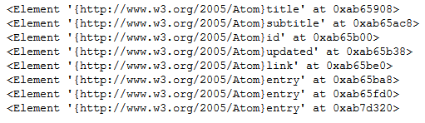
Loading Data Files
Reading a XML file
# Returning the root of the XML
import xml.etree.ElementTree as etree
tree=etree.parse('feed.xml')
root=tree.getroot()
root
# length (number of child) of the root
len(root)
# getting all the children of the root
for child in root:
print child

Slide 29
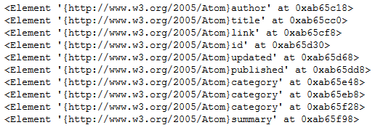
Loading Data Files
Reading a XML file
# Returning the attributes of an element
root[4].attrib
# getting all the children of the root
for child in root[5]:
print child

Slide 30

root.findall('{http://www.w3.org/2005/Atom}entry')
Loading Data Files
Reading a XML file
# Searching for an element in XML
root.findall('{http://www.w3.org/2005/Atom}entry') # looks for direct children only
all_links = tree.findall('//{http://www.w3.org/2005/Atom}link') # looks for all children irrespective of the nesting level

Slide 31
root.findall('{http://www.w3.org/2005/Atom}entry')
Loading Data Files
Connecting to a DB
import pyodbc
db_userName =‘xxxxxxx’ # passing db username and password
db_passwd=‘xxxxxxxx’
def teradata_conn():
conn = pyodbc.connect("Driver={driver name (Teradata,mySQL)}; DBCName=dbname; Authentication=TD2; UID=%s; PWD=%s" % (db_userName, db_passwd))
cursor = conn.cursor()
return cursor # establishing the db connection
q1 = 'del from '+table_name+'temp'
cursor.execute(q1)
cursor.commit() # executing a query

Slide 32
Writing results to a file
Data frames can be written to a files such as .csv, .txt, .xlsx etc.
Example 1: dfname.to_csv(‘file1.csv’)
Example 2: dfname.to_csv(‘file1.csv’,sep=‘/t’)
Example 3: dfname.to_csv(‘file1.csv’,sep=‘/t’,index=TRUE, index_label=indexname)
Example 4: dfname.to_excel(‘file2.xlsx’,sheet_name=‘Sheet1’)
Example 5:
import xlsxwriter
workbook = xlsxwriter.Workbook('simple_data.xlsx')
worksheet = workbook.add_worksheet('simple1')
worksheet.write(row,col,item)

Slide 33
Basic Exploration of Data
Goal | Code snippet
Looking at first few rows of the data | data.head(); data.head(10)
Looking at last few rows of the data | data.tail(); data.tail(10)
Finding the shape (# rows, colums) | data.shape
Finding the column names | data.column.values
Finding the basic statistics of numeric columns | data.describe()
Finding the data type of columns | data.dtypes
Calculate correlation b/w suitable columns | data.corr()
Calculate covariance b/w suitable columns | data.cov()

Slide 34
Change a variable type
Goal | Method
Converting numeric variable to string | str(numeric_col)
Converting string variable to numeric | int(str_col)
Converting string variable to float | float(str_col)
Converting string date to date type | datetime.striptime(datestring,format)
Converting categorical to binary | data[‘y_n']=(data['y_n']=='yes').astype(int)
from datetime import datetime
chartime1 = 'Jul 27 2016 5:45 PM'
chartime2='28/12/2016'
chartime3='12/31/2016 23:24'
dato1=datetime.strptime(chartime1,'%b %d %Y %I:%M %p')
dato2=datetime.strptime(chartime2,'%d/%m/%Y')
dato3=datetime.strptime(chartime3,'%m/%d/%Y %H:%M')
print dato1
print dato2
print dato3
dato1.year
dato1.month
dato1.day
dato1.hour
dato1.minute

Slide 35
Change a variable type
Finding all variable of a particular data type
def coltype(data):
column_list=data2.columns.values.tolist()
integer=[]
string=[]
floatcol=[]
for column in column_list:
if data2[column].dtype=='O':
string.append(column)
elif data2[column].dtype=='int64':
integer.append(column)
else:
floatcol.append(column)
return integer, string, floatcol

Slide 36
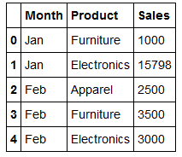
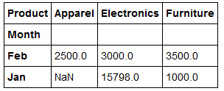
Transposing a dataset
data9=pd.read_csv('Transpose.csv')
data9t=data9.pivot(index='Month',columns='Product',values='Sales')

Slide 37
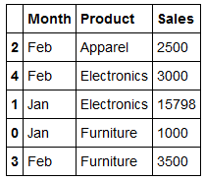
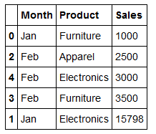
Sorting a dataset
data9.sort(['Product','Sales'],ascending=True)
data9.sort(['Sales','Product'],ascending=True)

Slide 38
Sub-setting a dataset
Selecting a column
account_length=data['Account Length']
data[['Account Length','VMail Message','Day Calls']]
wanted_columns=['Account Length','VMail Message','Day Calls']
subdata=data[wanted]
subdata.head()
wanted=['Account Length','VMail Message','Day Calls']
column_list=data.columns.values.tolist()
sublist=[x for x in column_list if x not in wanted]
subdata=data[sublist]
subdata.head()
Use Customer Churn Model.txt for this slide

Slide 39
Sub-setting a dataset
Selecting rows
data[0:50]
data1=data[data['Total Mins']>500]
data1=data[(data['Total Mins']>500) & (data['State']=='VA')]
data1=data[(data['Total Mins']>500) | (data['State']=='VA')]

Slide 40
Sub-setting a dataset
Selecting rows and columns
subdata_first_50=data[['Account Length','VMail Message','Day Calls']][0:50]
data.ix[1:100,1:6]
data.ix[:,1:6]
data.ix[1:100,:]
data.ix[1:100,[2,5,7]]
data.ix[[1,2,5],[2,5,7]]
data.ix[[1,2,5],['Area Code','VMail Plan','Day Mins']]

Slide 41
Creating a new column
data['Total Mins']=data['Day Mins']+data['Eve Mins']+data['Night Mins']
data[‘DERatioMins']=data['Day Mins']/data['Eve Mins']

Slide 42
Identify Unique Values
Drop duplicates
# Drop the rows with same value of one or more than one column
data2.drop_duplicates(['State','Area Code'])
data2[['State','Area Code']].drop_duplicates(['State','Area Code'])
Unique
# Find the unique values of a column of a data frame
data2['State'].unique()

Slide 43
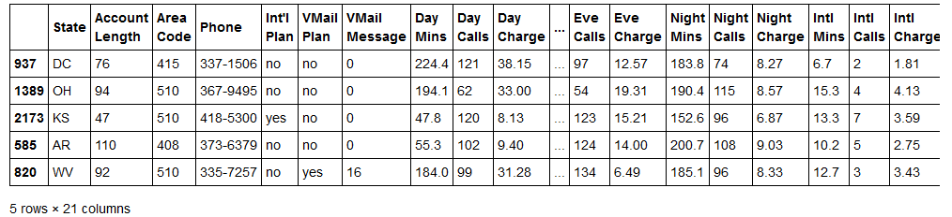
Sampling random rows
import numpy as np
from random import sample
def data_sample(data,size):
index=np.array(sample(xrange(len(data)),size))
return data.ix[index]
data_sample(data2,5)

Slide 44
Sampling random rows
Splitting a dataset into training and testing datasets
Using random numbers
import numpy as np
a=np.random.randn(len(data2))
check=a<0.8
training=data2[check]
testing=data2[~check]
len(training)
len(testing)
2) Using scikit learn
from sklearn.cross_validation import train_test_split
train, test = train_test_split(data2, test_size = 0.2)

Slide 45
Sampling random rows
Splitting a dataset into training and testing datasets
3) Using the shuffle function
with open('Customer Churn Model.txt','rb') as f:
data=f.read().split('\n')
np.random.shuffle(data)
train_data = data[:3*len(data)/4]
test_data = data[len(data)/4:]

Slide 46
Renaming Data frame columns
Creating a new data frame with new column names:
datarename=data2.rename(columns={'State':'A','Phone':'B'})
Replacing the column names in the same data frame
data2.rename(columns={'State':'A','Phone':'B'},inplace=True)

Slide 47
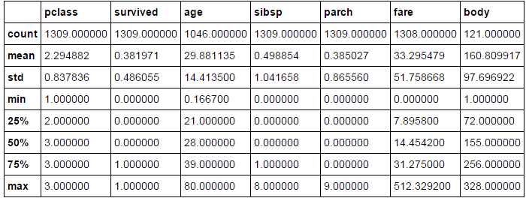
Handling missing values
Missing values can enter data during:
1) Data Extraction 2) Data Collection
Important to take care of missing values as they propagate the missing values to the result of a numeric operation and can lead to wrong interpretation of data
NaN is considered missing values. None is also considered missing values by isnull and notnull functions.

Slide 48
Handling missing values
Finding cells which have missing values:
pd.isnull(data[‘body’]) #returns TRUE if a cell has missing values
pd.notnull(data[‘body’]) #returns TRUE if a cell doesn’t have missing values
Finding the number of missing values in a column
pd.isnull(data['body']).values.ravel().sum() #returns the total number of missing values
pd.nottnull(data['body']).values.ravel().sum() #returns the total number of non-missing values
There are two main ways to take care of missing values
1) Deletion and 2) Imputation
Use titanic3.csv dataset for this example

Slide 49
Handling missing values
Deletion
Dropping all the rows where all the cells have missing values
data.dropna(axis=0,how='all') # axis=0 means along rows
Dropping all the rows where any the cells have missing values
data.dropna(axis=0,how='all')

Slide 50
Handling missing values
Imputation
Imputation is the method of adding/replacing missing values with some other values like 0, some string, or mean of that variable etc.
data.fillna(0) # imputes all the missing values in dataset with 0
data.fillna(‘text’) # imputes all the missing values with specified text
data[‘body’].fillna(0) # imputes only the missing values in ‘body’ column with 0
data['age'].fillna(data['age'].mean()) # impute with mean of non-missing values

Slide 51
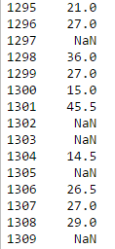
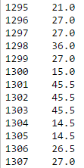
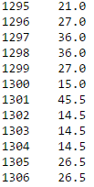
Handling missing values
Imputation
data['age'].fillna(method='ffill')
data['age'].fillna(method=‘backfill')

Slide 52
Applying Functions
Writing a function using lambda:
f1=lambda x:x+'-US'
f2=lambda x:pow(x,2)
f3=lambda x,y:x/y
f4=lambda x:(x-avg)**2
Applying a function to each element of a column:
data2['Day Charge'].map(f2)
data2[‘State'].map(f2)
import numpy as np
import math
avg=np.mean(data2['Day Charge'])
std_dev=math.sqrt(np.mean(data2['Day Charge'].map(f4)))

Slide 53
Applying Functions
Applying a function across rows or columns
data2[['Day Charge','Eve Charge']].apply(sum,axis=1) #[summing across columns]
data2[['Day Charge','Eve Charge']].apply(sum,axis=0) #[summing across rows]
Applying a function across each element of a data frame
Each column of the data frame should be of the same data type
data2[['Day Charge','Eve Charge']].applymap(f2)

Slide 54
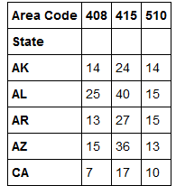
Cross Tab
Creating summary tables using crosstab
table1=pd.crosstab(data2['State'],data2['Area Code'])

Slide 55
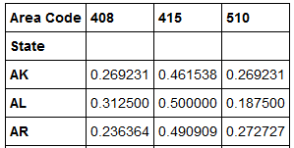
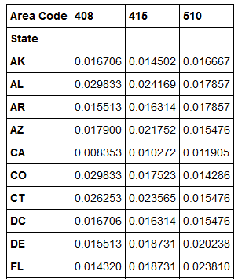
Cross Tab
Creating percentage summary across rows using crosstab
table2=pd.crosstab(data2['State'], data2['Area Code']).apply(lambda r: r/r.sum(), axis=1)
Creating percentage summary across columns using crosstab
table2=pd.crosstab(data2['State'], data2['Area Code']).apply(lambda r: r/r.sum(), axis=0)

Slide 56
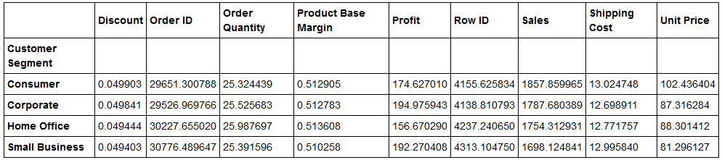
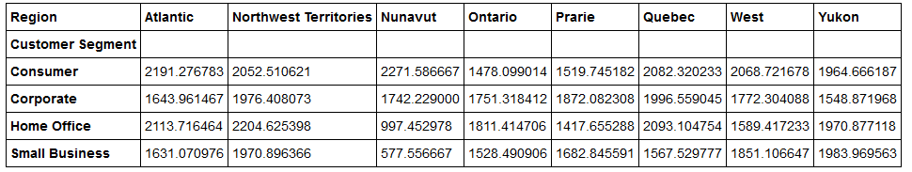
Pivot Tables
datastr=pd.read_csv('Superstore.csv')
table3=pd.pivot_table(datastr,index=['Customer Segment']) # the aggregate values are average by default
table2=pd.pivot_table(datastr,values='Sales',index=['Customer Segment'],columns=['Region'])

Slide 57
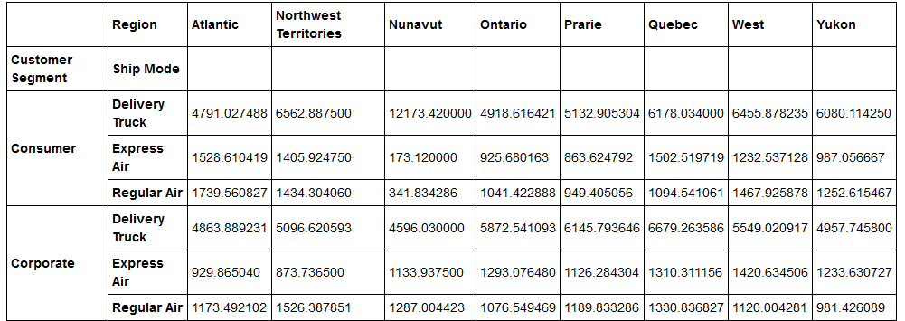
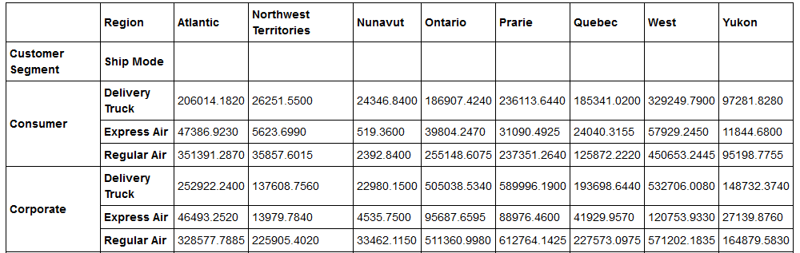
Pivot Tables
datastr=pd.read_csv('Superstore.csv')
table4=pd.pivot_table(datastr,values='Sales',index=['Customer Segment','Ship Mode'],columns=['Region'])
table5=pd.pivot_table(datastr,values='Sales',index=['Customer Segment','Ship Mode'],columns=['Region'],aggfunc=sum)

Slide 58
Pivot Tables
If you expect missing values in your pivot table, then use fill.values=0
table4=pd.pivot_table(datastr,values='Sales',index=['Customer Segment','Ship Mode'],columns=['Region'],fill_values=0)
If you want totals at the end, use margins=TRUE
table4=pd.pivot_table(datastr,values='Sales',index=['Customer Segment','Ship Mode'],columns=['Region'],fill_values=0,margins=TRUE)
One can pass different aggregate functions to different value columns
table6=pd.pivot_table(datastr,values=['Sales','Unit Price'],index=['Customer Segment','Ship Mode'],columns=['Region'],aggfunc={"Sales":sum,"Unit Price":len})

Slide 59
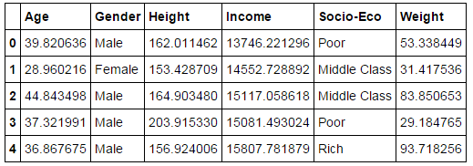
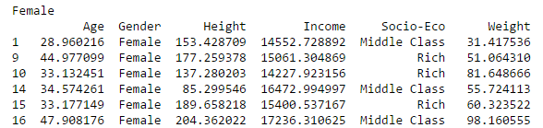
Grouping the data
Groupby groups the data based on similar values of categorical variables
creates a groupby object which has two attributes viz. name and group
There would be as many groups as there are categories in the variable
Group by gender

Slide 60
Grouping the data
grouped=datastr.groupby('Ship Mode') # grouping by Ship Mode
for names,groups in grouped: # printing the group names and member rows
print names,groups
len(grouped) # number of groups in the data frame
len(datastr['Ship Mode'].unique()) # number of unique values of Ship Mode
grouped.get_group('Delivery Truck') # getting a particular group
grouped[‘Shipping Cost’] # retrieving one column from the grouped object
values should be same

Slide 61
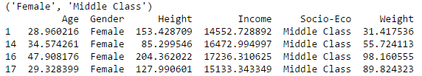
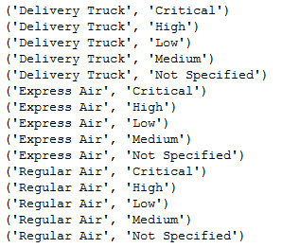
Grouping the data
One can group by 2 columns as well
grouped=datastr.groupby(['Ship Mode','Order Priority'])
for names,groups in grouped:
print names

Slide 62
Grouping the data
Miscellaneous operations with groupby
Finding the first/last row of the group
grouped.head(1) # returns the first row of all the groups
grouped.tail(1) # returns the last row of all the groups
Finding the cheapest/costliest order item of each group
datastr1=datastr.sort('Unit Price') # sort (ascending order) by Unit Price
grouped=datastr1.groupby(['Ship Mode','Order Priority']) # group by Ship Mode and Order Priority
grouped.head(1) # first row i.e. the cheapest order item in each group
grouped.tail(1) # last row i.e the costliest order item in each group
Finding the nth row in the group
grouped.nth(2)

Slide 63
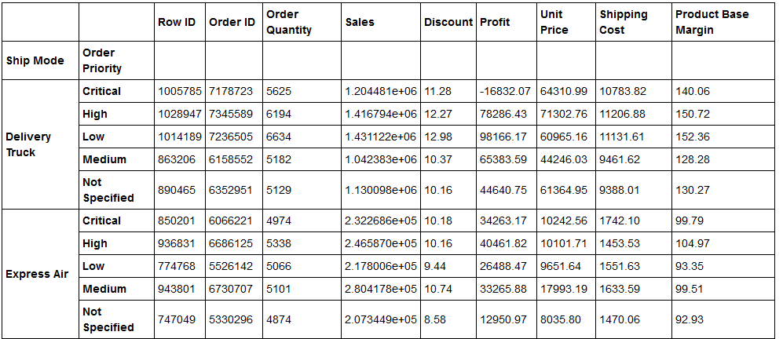
Grouping the data
Aggregating using group by
grouped.sum() # returns the sum of all numeric columns for each group
grouped.size()

Slide 64
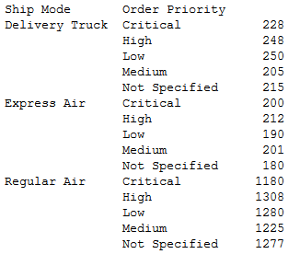
Grouping the data
Aggregating using group by
grouped.size() # returns the number of records for each group
table=grouped.size()
table.to_csv('test.csv') # all such results can be written to a csv

Slide 65
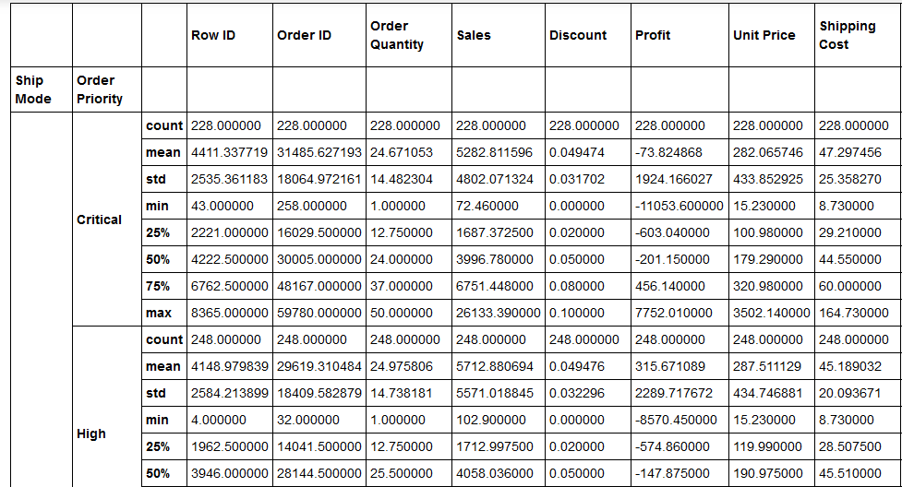
Grouping the data
Aggregating using group by
grouped.describe() # returns the basic stats for numeric columns of each group

Slide 66
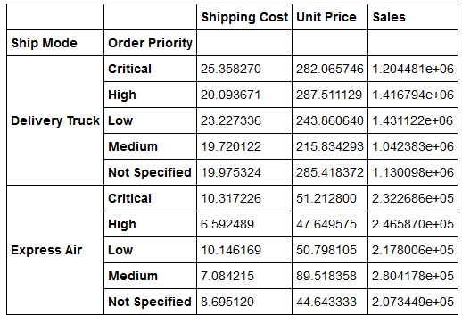
Grouping the data
Aggregating using group by
grouped.aggregate({'Sales':np.sum,'Unit Price':np.mean,'Shipping Cost':np.std}) # applying different aggregate functions to different columns for each group
grouped.aggregate({'Sales':np.sum,'Unit Price':np.mean,'Shipping Cost':lambda x:np.mean(x)/np.std(x)}) #lambda functions can also be used

Slide 67
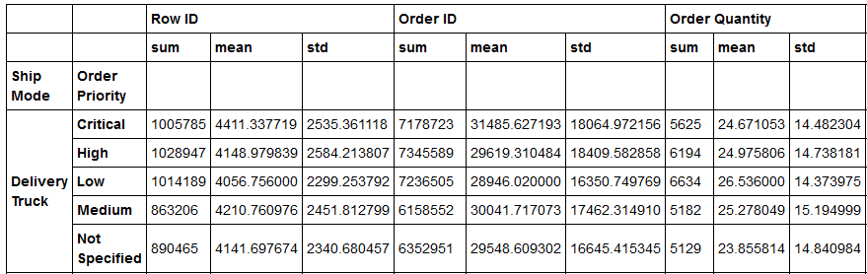
Grouping the data
Aggregating using group by
grouped.aggregate([np.sum, np.mean, np.std])
# applying several functions to each column for each group

Slide 68
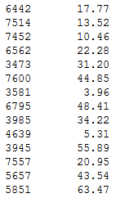
Grouping the data
Filtering using group by
grouped['Sales'].filter(lambda x:x.sum()>5000) #returns all the rows (with row ID and Sales values) for all the groups for which sum of Sales is greater than 5000

Slide 69
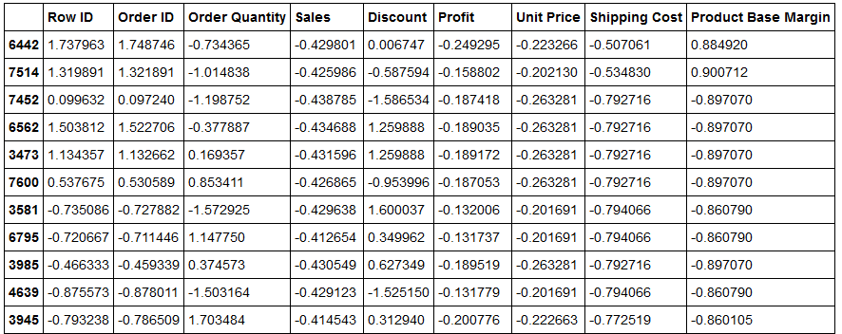
Grouping the data
Transformation using group by
zscore = lambda x: (x - x.mean()) / x.std()
grouped.transform(zscore) # transform each value using a lambda function for each group

Slide 70
Concatenating Data
The constituent datasets should have similar shapes
More than two datasets can also be concatenated
datarw=pd.read_csv('winequality-red.csv',sep=";")
datarw.shape
dataww=pd.read_csv('winequality-white.csv',sep=";")
dataww.shape
datatot=pd.concat([datarw,dataww],axis=0)
datatot.shape
datatot1=pd.concat([datarw,dataww],axis=1)
datatot1.shape

Slide 71
Concatenating Data
Concatenate more than two datasets
The order of appearance of datasets matters in the output dataframe
data1_head=data1.head(50)
data1_middle=data1[500:550]
data1_tail=data.tail(50)
wine_scramble=pd.concat([data1_middle,data1_head,data1_tail],axis=0) # the order of appearance matters
wine_scramble
data1_head=data1.head(50)
data1_middle=data1[500:550]
data1_tail=data.tail(50)
wine_scramble=pd.concat([data1_head,data1_middle,data1_tail],axis=0)
wine_scramble

Slide 72
Concatenating Data
Concatenate many similar files in a single file
data_final=pd.read_csv('lotofdata/001.csv')
for i in range(1,333):
if i<10:
filename='0'+'0'+str(i)+'.csv'
if 10<=i<100:
filename='0'+str(i)+'.csv'
if i>=100:
filename=str(i)+'.csv'
file='lotofdata'+'/'+filename
data=pd.read_csv(file)
print data.shape
data_final=pd.concat([data_final,data],axis=0)
print data_final.shape
Steps
Read the first file from the lot
Loop over all the files, get the correct filenames and read them
Concatenate the read file to the first file
Keep concatenating the next files to the intermediate file
Stop when all the files are concatenated

Slide 73
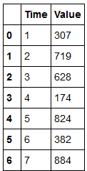
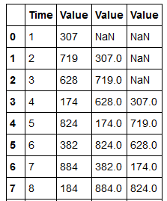
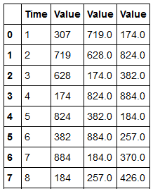
Miscellaneous operations
Creating lag variables
data_ll=pd.read_csv('Lead_Lag.csv')
lag1=data_ll['Value'].shift(1)
lag3=data_ll['Value'].shift(3)
data_ll1=pd.concat([data_ll,data_ll['Value'].shift(1),data_ll['Value'].shift(3)],axis=1)
data_ll2=pd.concat([data_ll,lag1,lag3],axis=1)
data_ll1
Creating lead variables
lead1=data_ll['Value'].shift(-1)
lead3=data_ll['Value'].shift(-3)
data_ll3=pd.concat([data_ll,lead1,lead3],axis=1)

Slide 74
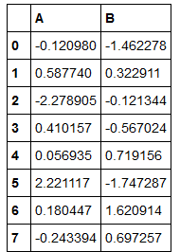
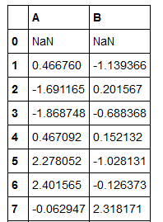
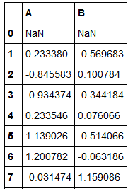
Miscellaneous operations
Rolling functions
df_rand=pd.DataFrame(np.random.randn(100,2),columns=['A','B'])
df_rol2_sum=df_rand.rolling(2).sum()
df_rol2_mean=df_rand.rolling(2).mean()
Rolling sum
Rolling mean

Slide 75
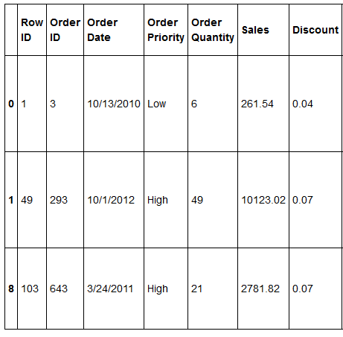
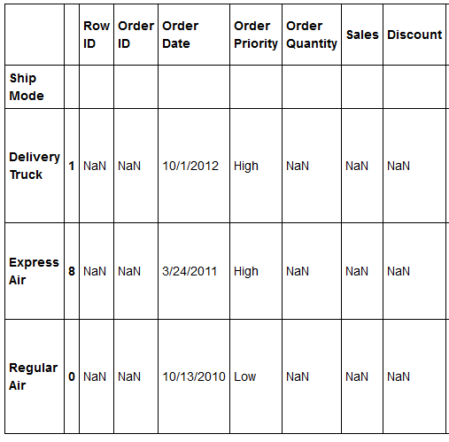
Miscellaneous operations
Rolling functions in Group By
Rolling starts separately for each group
grouped=datastr.groupby('Ship Mode')
grouped.head(1)
# applies to all the numeric columns
grouped=datastr.groupby('Ship Mode').rolling(2).mean()
grouped[pd.isnull(grouped['Sales'])]

Slide 76
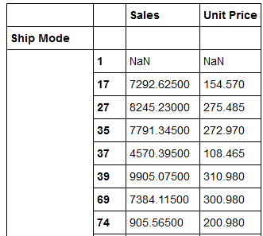
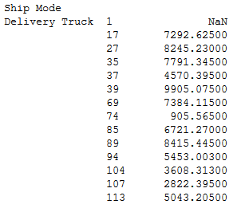
Miscellaneous operations
Rolling functions in Group By
# Rolling for just one column
grouped=datastr.groupby('Ship Mode')['Sales'].rolling(2).mean()
grouped
# Rolling for two columns
grouped=datastr.groupby('Ship Mode')['Sales','Unit Price'].rolling(2).mean()
grouped

Slide 77

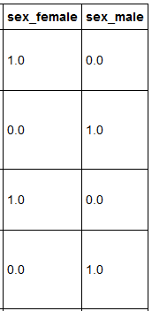
Miscellaneous operations
Creating dummy variables
Categorical variables can’t go as they are in the models. They need to be vectorised or converted into dummy variables
datatitan=pd.read_csv('titanic3.csv')
dummy_sex=pd.get_dummies(datatitan['sex'],prefix='sex')
column_name=datatitan.columns.values.tolist()
column_name.remove('sex')
datatitan=pd.concat([datatitan[column_name],dummy_sex],axis=1)
datatitan.head()

Slide 78
Miscellaneous operations
Creating dummy variables
Categorical variables can’t go as they are in the models. They need to be vectorised or converted into dummy variables
datatitan=pd.read_csv('titanic3.csv') # creating a dummy column using label encoding
from sklearn import preprocessing
le_sex = preprocessing.LabelEncoder()
sex_dummy = le_sex.fit_transform(datatitan['sex'])
list(le_sex.classes_) # list the categories of the categorical variable
le_sex.inverse_transform(sex_dummy) #decode the dummy variavle to categorical variable

Slide 79


Merging Data
Data comes from various sources/tables
They need to be merged/joined
Mission critical part of data preparation
Can be used for mapping
Merge/Join happen over primary key(s)
Different types: Inner, Outer, Left, Right
T1
T2

Slide 80


Merging Data
Returns only the rows for which the primary key has values in both the tables
In the example below, there would be just two rows for S2 and S3, as they are the only common value of primary key among both the table
Inner Join
T1
T2

Slide 81


Merging Data
Returns all the rows for which the primary key has values in the table on the left side
In the example below, there would be four rows corresponding to four values of primary key in the table T1
The Age column would have Null values in the rows where there is no match for primary key values in T1
Left Join
T1
T2

Slide 82


Merging Data
Returns all the rows for which the primary key has values in the table on the right side
In the example below, there would be three rows corresponding to three values of primary key in the table T2
The Eng_Marks and Math_Marks columns would have Null values in the rows where there is no match for primary key values in T2
Right Join
T1
T2

Slide 83

Merging Data
data_main=pd.read_csv('medals.csv')
data_main.head()
a=data_main['Athlete'].unique().tolist()
len(a)
There are 8618 rows and 6956 unique Athletes

Slide 84


Merging Data
data_country=pd.read_csv('Athelete_Country_Map.csv')
data_country.head()
data_country.shape
data_sports=pd.read_csv('Athelete_Sports_Map.csv')
data_sports.head()
data_sports.shape
There are 6956 unique Athletes but 6970 rows as some players like ‘Aleksandar Ciric’ have played for two countries
There are 6956 unique Athletes but 6975 rows as some players like ‘Chen Jing’ have played two sports

Slide 85


Merging Data
pv=pd.pivot_table(data_sports,index=['Athlete'],values='Sport',aggfunc=len).copy().sort_values(ascending=False)
pv1=pd.pivot_table(data_country,index=['Athlete'],values='Country',aggfunc=len).copy().sort_values(ascending=False)
pv1

Slide 86

Merging Data
Merge/Join in pandas
merge_inner=pd.merge(left=data_main,right=data_country,how='inner',left_on='Athlete',right_on='Athlete')
merge_inner.shape
The merge_inner has 8657 rows and 9 columns; one extra column which is country

Slide 87
Merging Data
Merge/Join in pandas
Let us delete the records for 5 athletes from the data_country and data_sports to see how the different kind of joins affect the merged data
data_sports_dlt=data_sports[(data_sports['Athlete']<>'Michael Phelps') & (data_sports['Athlete']<>'Natalie Coughlin') & (data_sports['Athlete']<>'Chen Jing')
& (data_sports['Athlete']<>'Richard Thompson') & (data_sports['Athlete']<>'Matt R

Slide 88
Merging Data
Merge/Join in pandas
Inner Join
Left Join
Right Join
merge_inner=pd.merge(left=data_main,right=data_sports_dlt,how='inner',left_on='Athlete',right_on='Athlete')
merge_inner.shape
a=merge_inner['Athlete'].unique().tolist()
len(a)
merge_left=pd.merge(left=data_main,right=data_sports_dlt,how='left',left_on='Athlete',right_on='Athlete')
merge_left.shape
a=merge_left['Athlete'].unique().tolist()
len(a)
merge_right=pd.merge(left=data_main,right=data_sports_dlt,how='right',left_on='Athlete',right_on='Athlete')
merge_right.shape
a=merge_right['Athlete'].unique().tolist()
len(a)
6951
6956
6951

Slide 89
Merging Data
Merge/Join in pandas
Merge while adding a suffix to duplicate column names
pd.merge(df_1, df_2, left_on=‘key1', right_on=‘key2’, how='left', suffixes=('_left', '_right'))
Merge based on indexes
pd.merge(df_1, df_2, right_index=True, left_index=True)

Slide 90
Generating a dummy data frame
Dummy data frame can be generated using dictionaries, keys of which would hold column names and values the values in that column
A data frame having 10 rows and 2 numeric columns
import pandas as pd
import numpy as np
d=pd.DataFrame({'A':np.random.randn(10),'B':2.5*np.random.randn(10)+1.5})
A data frame having 10 rows , 2 numeric columns and 1 categorical column
import pandas as pd
import numpy as np
data = pd.read_csv('Customer Churn Model.txt')
column_list=data.columns.values.tolist()
a=len(column_list)
d=pd.DataFrame({'Column_Name':column_list,'A':np.random.randn(a),'B':2.5*np.random.randn(a)+1.5})

Slide 91

Generating a dummy data frame
Dummy data frame can be generated using dictionaries, keys of which would hold column names and values the values in that column
A data frame with a mix of numerical and categorical variables getting values from a list
import numpy as np
import pandas as pd
a=['Male','Female']
b=['Rich','Poor','Middle Class']
gender=[]
seb=[]
for i in range(1,101):
gender.append(np.random.choice(a))
seb.append(np.random.choice(b))
height=30*np.random.randn(100)+155
weight=20*np.random.randn(100)+60
age=10*np.random.randn(100)+35
income=1500*np.random.randn(100)+15000
df=pd.DataFrame({'Gender':gender,'Height':height,'Weight':weight,'Age':age,'Income':income,'Socio-Eco':seb})
df.head()

Slide 92


Miscellaneous Operations
Calculate the frequency for a categorical variable
df['Gender'].value_counts() df['Socio-Eco'].value_counts()

Slide 93

Generating random numbers
Monte Carlo Simulation using Python
Use case estimating the value of Pi
Generate points with both x and y coordinates lying between 0 and 1
Calculate x*x + y*y. If it is less than 1, it lies inside the circle. If it is greater than it lies outside the circle
Calculate the total number of points which lie inside the circle. Divide it by the total number of points generated to get the probability of a point lying inside the circle.
Use this probability to calculate the value of pi
Repeat the process a sufficient number of times, say 1000 times and generate 1000 different values of pi
Take an average of all the 1000 values of pi to arrive at the final value of pi
Prob (point lying inside the circle) = Area of circle/Area of square
= pi*r*r/(2r*2r)
= pi/4

Slide 94
Generating random numbers
Monte Carlo Simulation using Python
Use case estimating the value of Pi
import numpy as np
import matplotlib.pyplot as plt
%matplotlib inline
pi_avg=0
pi_value_list=[]
for i in range(100):
value=0
x=np.random.uniform(0,1,1000).tolist()
y=np.random.uniform(0,1,1000).tolist()
for j in range(1000):
z=np.sqrt(x[j]*x[j]+y[j]*y[j])
if z<=1:
value+=1
float_value=float(value)
pi_value=float_value*4/1000
pi_value_list.append(pi_value)
pi_avg+=pi_value
pi=pi_avg/100
print pi
ind=range(1,101)
fig=plt.plot(ind,pi_value_list)
fig

Slide 95
Generating random numbers
Generating random numbers using Python
Goal | Snippet
Generating an integer random number between 1 and 100 | import numpy as np np.random.randint(1,100)
Generating a random number between 0 and 1 | import numpy as np np.random.random()
Generating a list of random numbers between two numbers | def randint_range(n,a,b): x=[] for i in range(n): x.append(np.random.randint(a,b)) return x randint_range(10,2,1000)
Generating a random number between 0 and 100 which is a multiple of 5 | import random random.randrange(0,100,5)

Slide 96
Generating random numbers
Generating random numbers using Python
Goal | Snippet
Change the order of elements in a list | import numpy as np a=range(100) np.random.shuffle(a)
Picking one random item from a list | a=range(1,100,2) np.random.choice(a)
Seeding the random numbers so that they can be reproduced | np.random.seed(1) for i in range(5): print np.random.random()

Slide 97
Generating random numbers
Generating random numbers using Python
Goal | Snippet
Generating 100 uniformly distributed random numbers b/w 1 and 100 | import numpy as np randnum=np.random.uniform(1,100,100)
Generating 100 standard normally distributed random numbers | import numpy as np a=np.random.randn(100)
Generating a matrix of 2X4 size containing standard normally distributed random numbers | import numpy as np a=np.random.randn(2,4)
Generate 100 normally distributed random numbers with std dev =2.5 and mean =1.5 | import numpy as np a=2.5*np.random.randn(100)+1.5

Slide 98


Generating random numbers
Generating random numbers using Python
import numpy as np
import matplotlib.pyplot as plt
%matplotlib inline
a=np.random.uniform(1,100,1000000)
b=range(1,101)
plt.hist(a)
import numpy as np
import matplotlib.pyplot as plt
%matplotlib inline
a=np.random.randn(1000000)
b=range(1,101)
plt.hist(a)
Becomes perfectly uniformly distributed for large number of iterations
Becomes almost perfectly normally distributed for large number of iterations

Slide 99
Linear Algebra with Python
m1=np.random.randn(2,2)
m2=np.random.randn(2,2)
m3=np.random.randn(3,2)
Goal | Code
Sum of two matrices | m1+m2
Multiplying with a scalar | 3*m1
Multiplying two matrices elementwise | m1*m2
Multiplying two matrices | np.dot(m1,m2)
Inverting a matrix | np.linalg.inv(m1)
Dividing two matrices | np.dot(m1, np.linalg.inv(m2))
Transpose a matrix | m1’

Slide 100
Linear Algebra with Python
Goal | Code
Computing the Eigenvector | np.linalg.eig(m1)
Computing the eigenvalues | np.linalg.eigvals(m1)
Solve a linear system of equation | a = np.array([[3,1], [1,2]]) b = np.array([9,8]) x = np.linalg.solve(a, b) x
Solve a linear system of equation | a = np.array([[3,1,2], [1,2,1],[3,3,4]]) b = np.array([9,8,10]) x = np.linalg.solve(a, b) x

